Slide 1

Reliability Design
By: Rasad Regmi

Slide 2
Introduction to Reliability Design
Reliability Design Problem In reliability design, the problem is to design a system that is composed of several devices connected in series.
Reliability design focuses on ensuring that a system performs its intended function without failure over a specified period.
Reliable systems minimize downtime and maintenance costs, ensuring consistent performance.

Slide 3
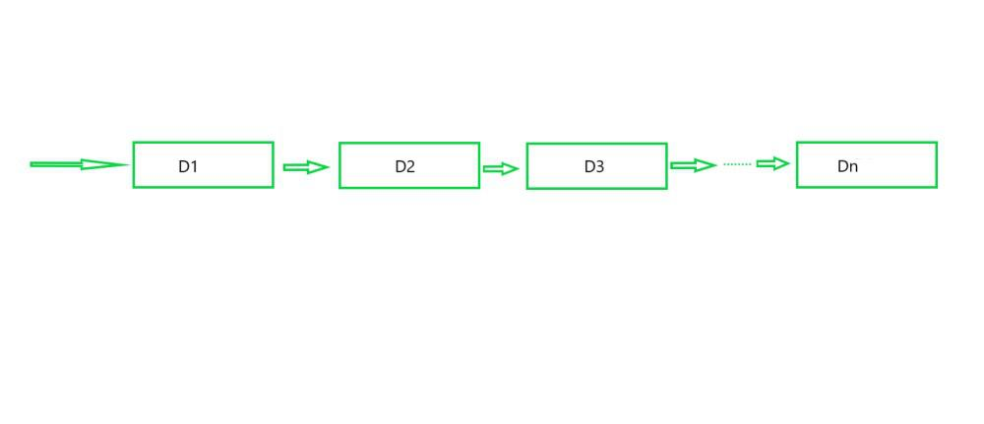
n devices D_{i}, 1<=i<=n, connected in series
Let r_{i} be the reliability of device Di (i.e. r_{i} is the probability that device i will function properly) then the reliability of the entire system is πr_{i}.
Even if the individual devices are very reliable, the reliability of the system may not be very good.
For example, if n=10 and r_{i} = 0.99, 1 ≤ i ≤ 10, then πr_{i} = 0.904.
Hence, it is desirable to duplicate devices. Multiple copies of the same device type are connected in parallel.

Slide 4
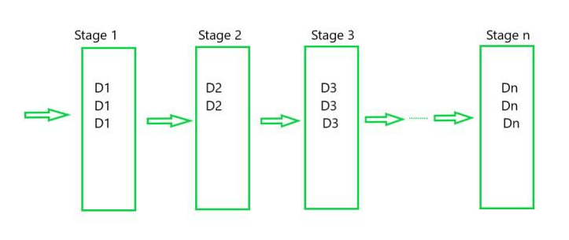
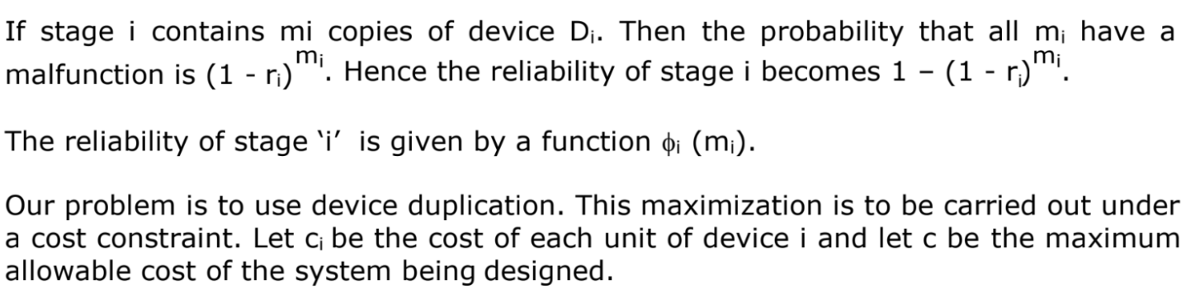
n devices D_{i}, 1<=i<=n, connected in series

Slide 5

Maximum number of copies for D_{i}

Slide 6
Dominance Rule
In reliability design, the dominance rule is a principle used to optimize system reliability by comparing different configurations or components.
The dominance rule (f1, x1) dominate (f2, x2) if f1 ≥ f2 and x1 ≤ x2. Hence, dominated tuples can be discarded from S^{i} (where i denotes stage number).

Slide 7
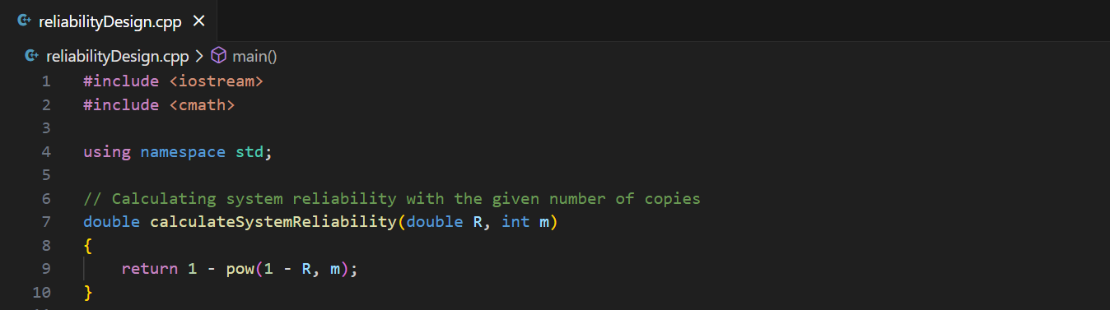
Code

Slide 8
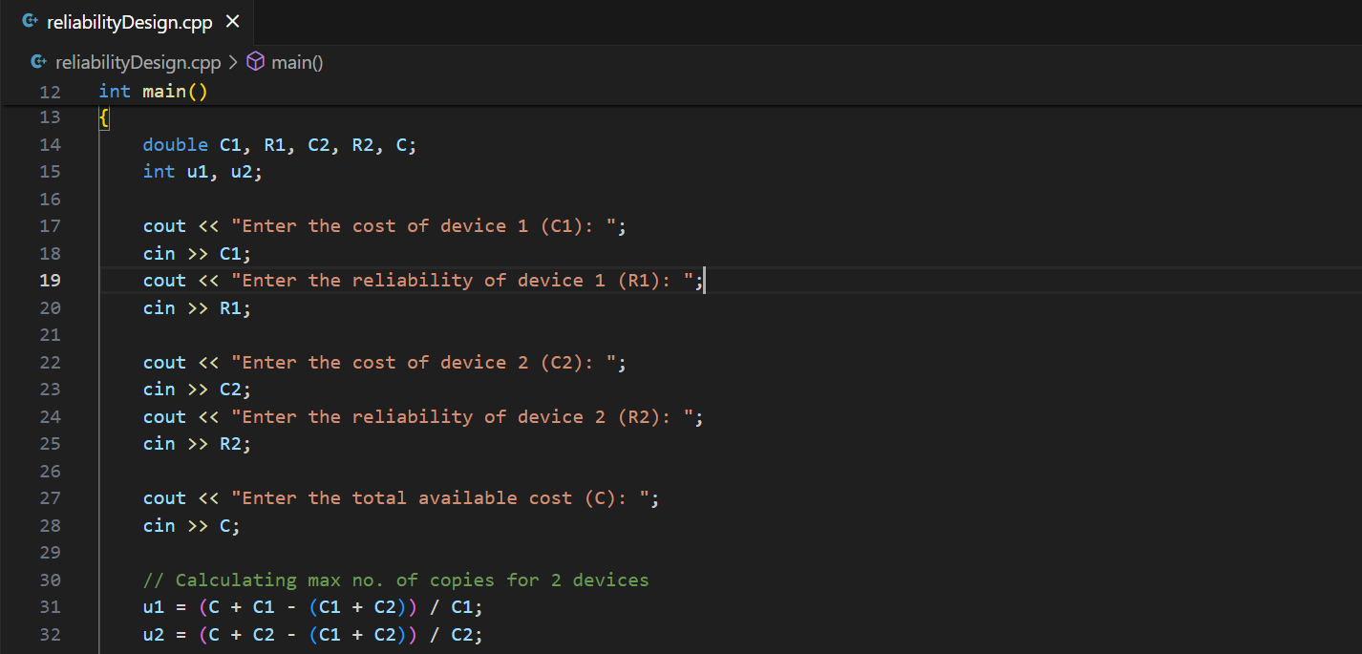

Slide 9
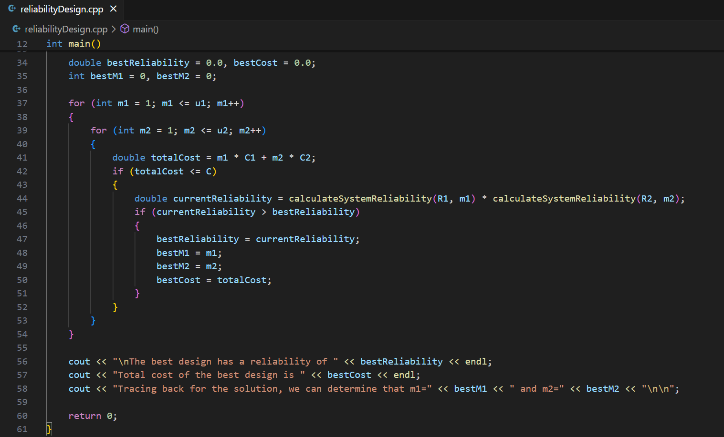

Slide 10


